Slide 1
Flyweight Pattern

Slide 2
Problem
Object will be created too many
Memory overwhelm
repetitive, slow, and inefficiently shares data.

Slide 3
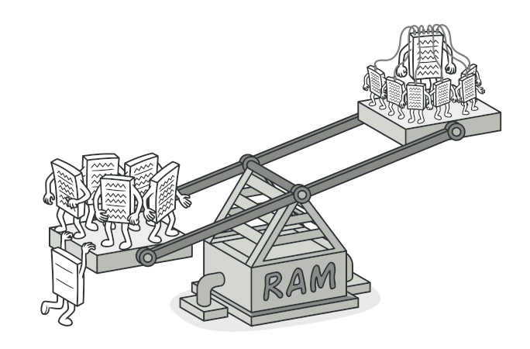
FlyWieght
is a structural design pattern that lets you fit more objects into the available amount of RAM by sharing common parts of state between multiple objects instead of keeping all of the data in each object.

Slide 4
We use this technique when
It aims to minimize the use of memory in an application
by sharing as much data as possible with related objects
decrease object count

Slide 5
flyweight objects is that they are immutable
Each object is divided into two pieces:
State-dependent (extrinsic) part : computed by client object
State-independent (intrinsic) part : in flyweight object

Slide 6
intrinsic
replaced with a single shared object, created by a factory method.
Intrinsic information may be required by internal methods in our objects, which they absolutely cannot function without.
Extrinsic
can however be removed and stored externally

Slide 7
Book object
ID
Title
Author
Genre
Page count
Publisher ID
ISBN
*****************
checkoutDate
checkoutMember
dueReturnDate
availability

Slide 8
Works fine initially for small collections
When expands we see a problem
management system running slower and slower over time
separate data into intrinsic and extrinsic states as follows: data relevant to the book object (title, author, etc.) → intrinsic
checkout data (checkoutMember, dueReturnDate, etc.)→ extrinsic have been removed.
Everything to do with library check-outs will be moved to a manager

Slide 9
Basic Factory
make sure that we only create a single copy of each unique intrinsic piece of data
Use singleton DP

